Slide 1
21MAT105
MATHEMATICS FOR INTTELLIGENT SYSTEMS
WRITTEN ASSIGNMENT

Slide 2
SUBMITTED BY BATCH-A TEAM11 TEAM MEMBERS : 1. VIKHYAT BANSAL [CB.EN.U4AIE21076] 2. VIGNESH M. [CB.EN.U4AIE21075] 3. YARRAM SRI SATHWIK REDDY [CB.EN.U4AIE21077] 4. MARREDDY MOHIT SASANK REDDY [CB.EN.U4AIE21031]

Slide 3
Formulate the second order differential equation for a mass-spring- damper system with mass m = 20 kg. The critically damped case for this system occurs when the damping constant b is 40. The initial velocity of the mass is zero and initial displacement is 1 meter. Solve the differential equation using (a) Euler's method (b) Euler's midpoint method and (c) RK4 method over the time period of 0 <= t <=15 s for (i) Undamped case (b=5) (ii) Critically damped case (iii) Overdamped case (b = 200). The interval h may be taken as 0.1 s. (Hint for numerical method: State space model)
1

Slide 4
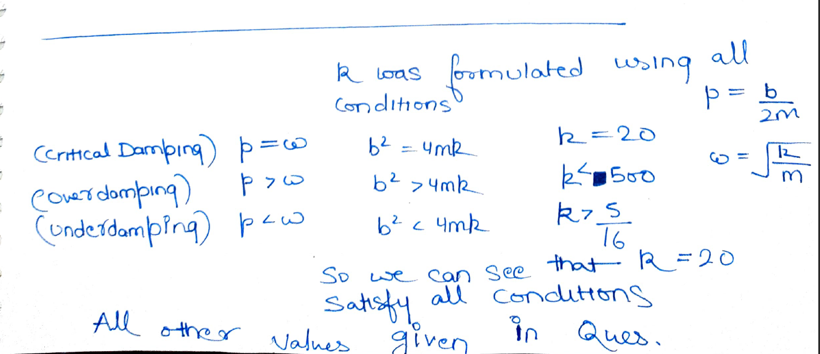
For 2nd Order Differential Equation

Slide 5
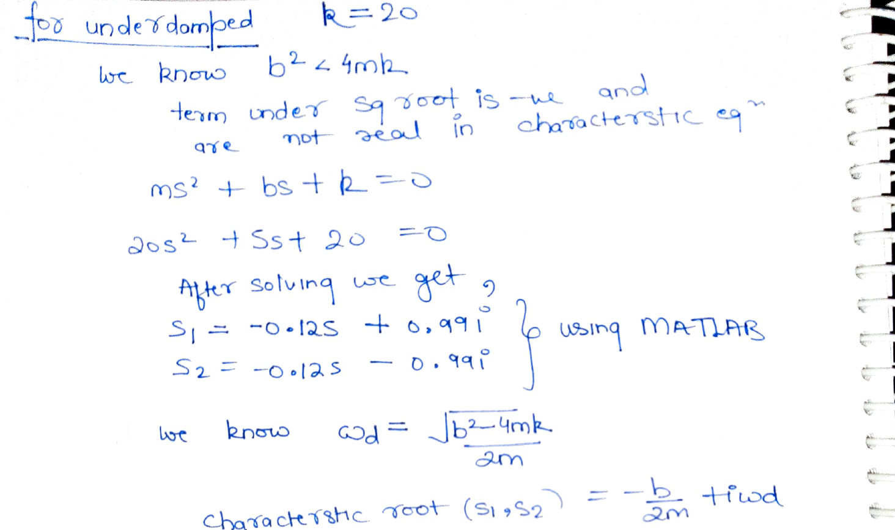
i.) Undamped Case (b=5)

Slide 6
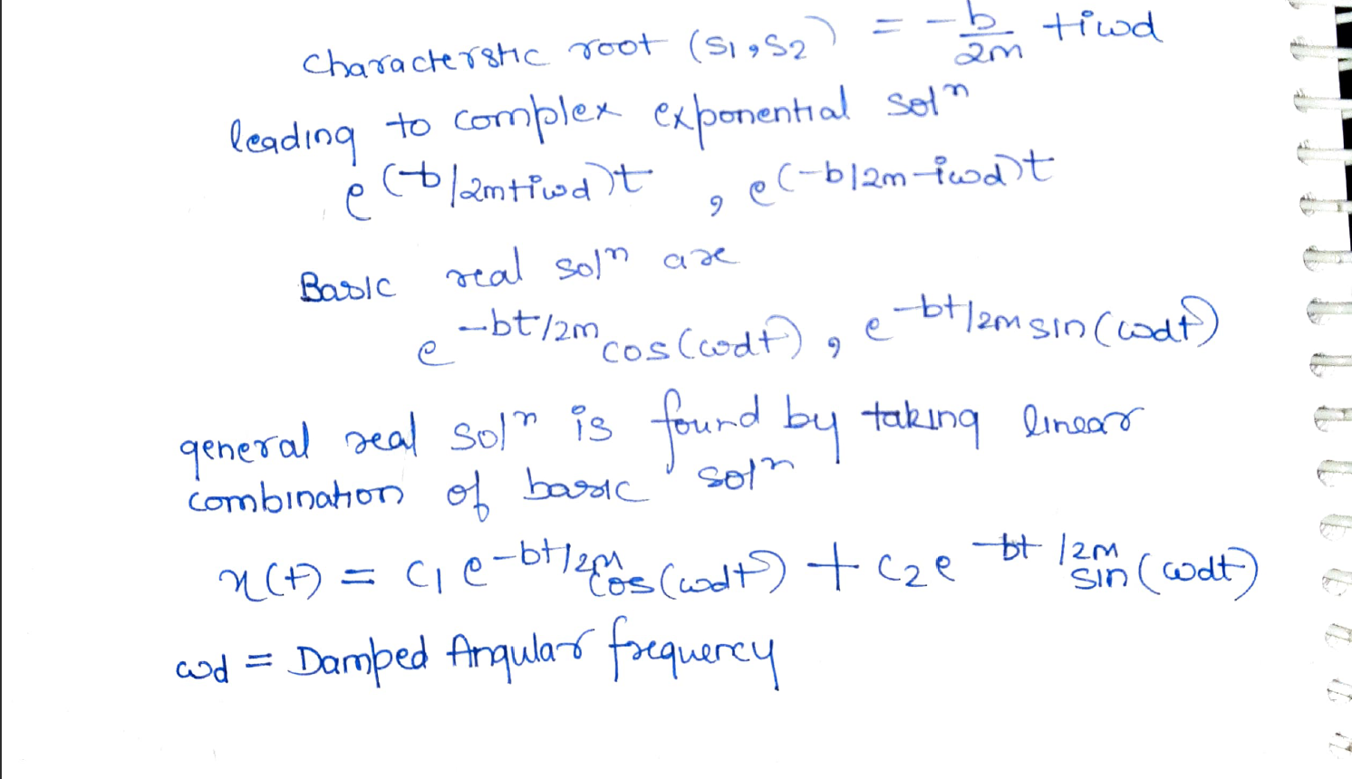

Slide 7
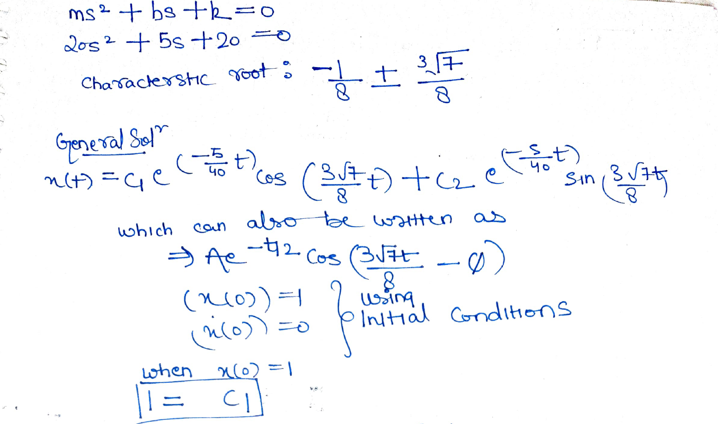

Slide 8
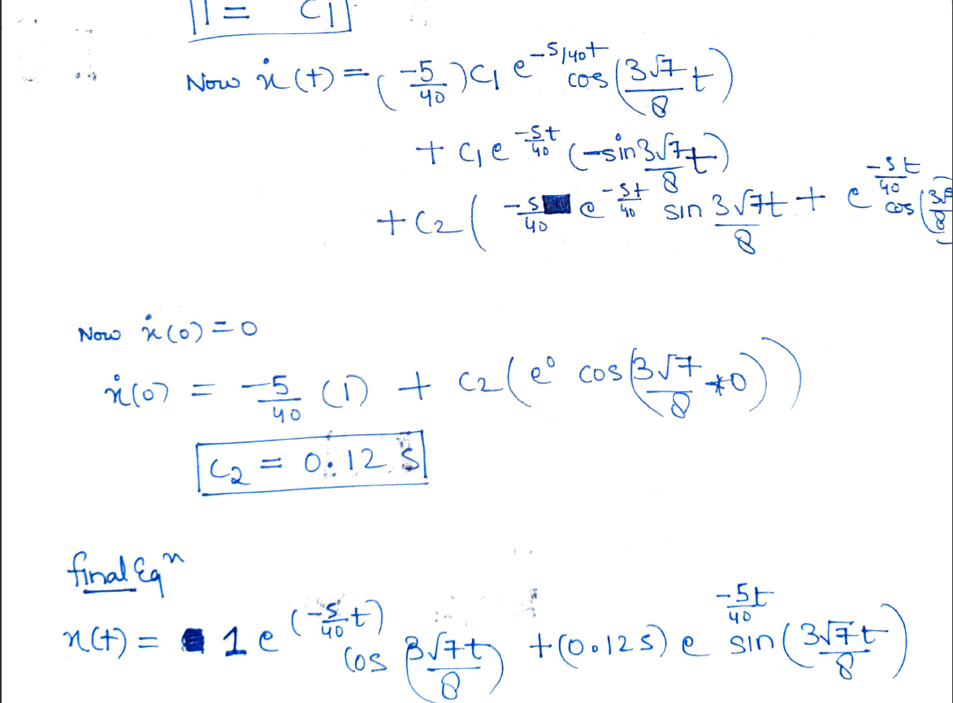

Slide 9
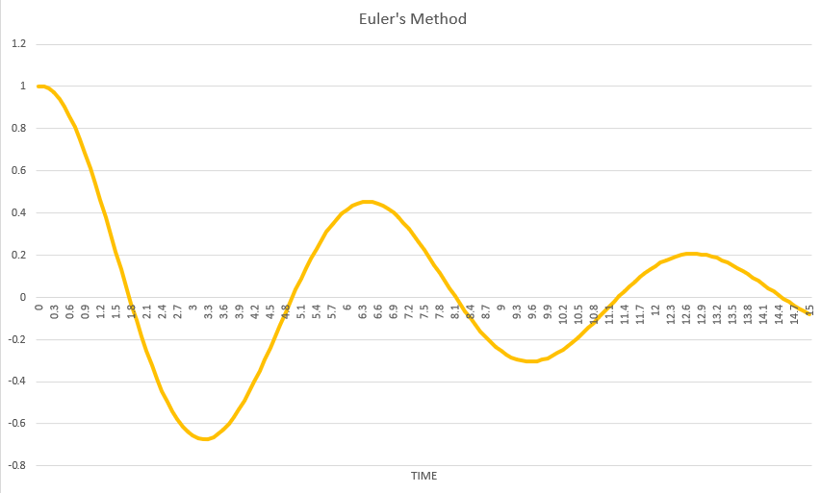
Using different numerical methods we can solve,
A) Euler’s Method

Slide 10
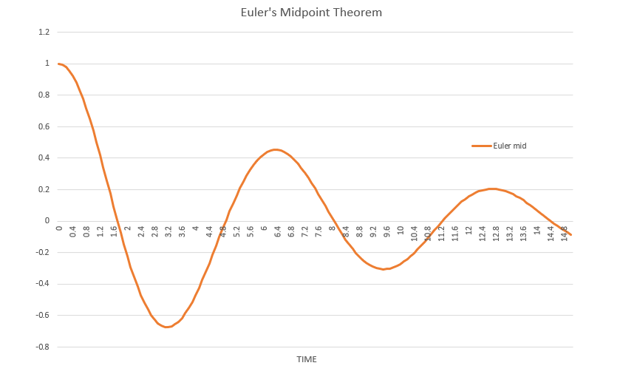
B) Euler’s Midpoint Method

Slide 11
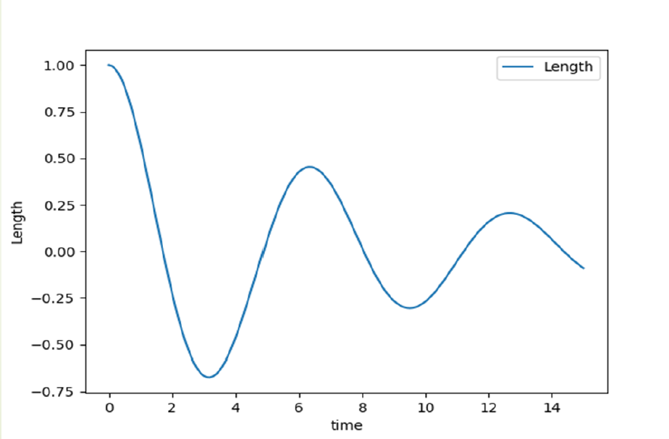
C) RK4 Method

Slide 12
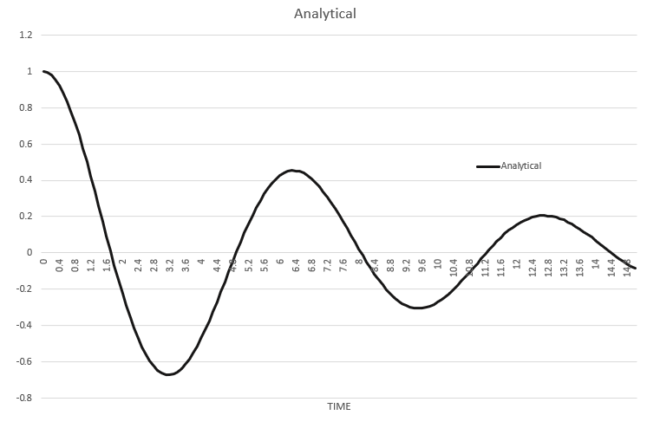
D) Analytical Method

Slide 13
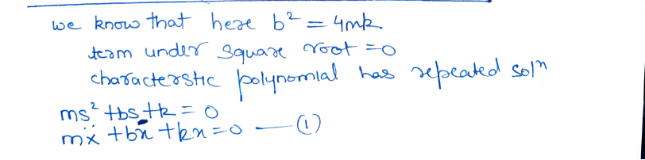
ii.) Critically damped Case (b=40)

Slide 14
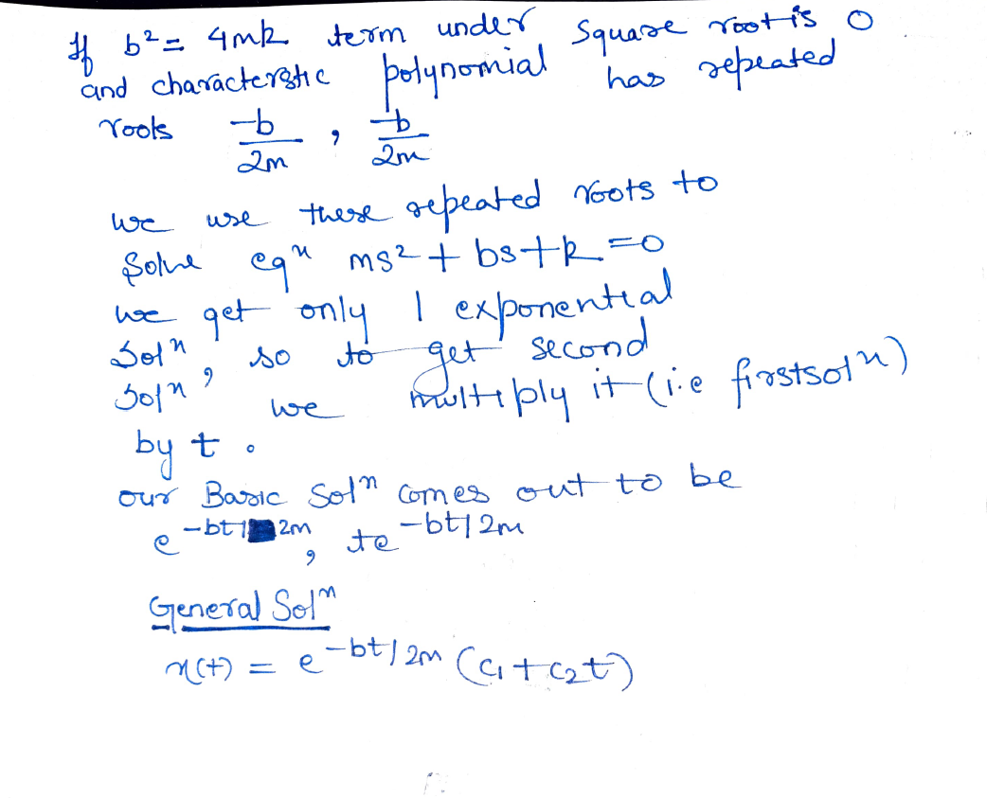

Slide 15
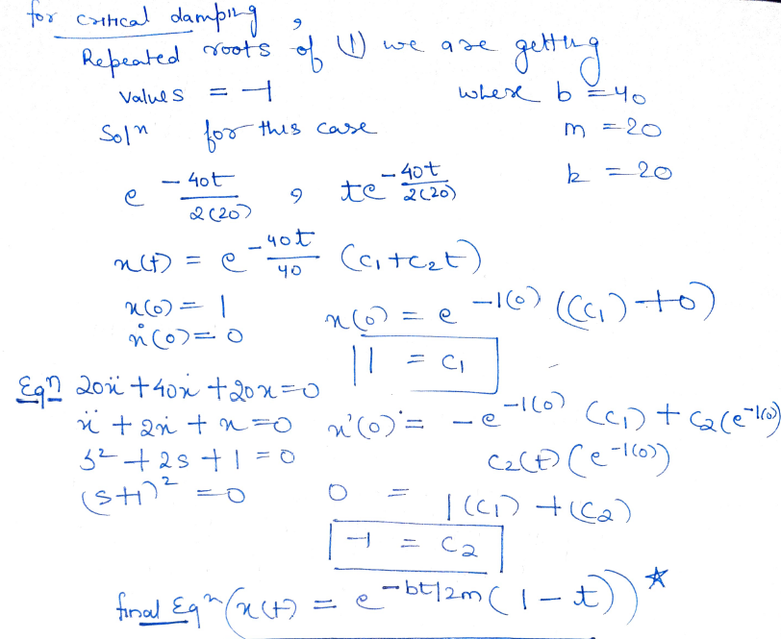

Slide 16
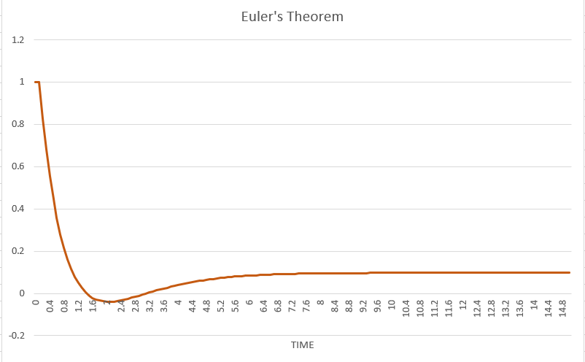
A) Euler’s Method

Slide 17
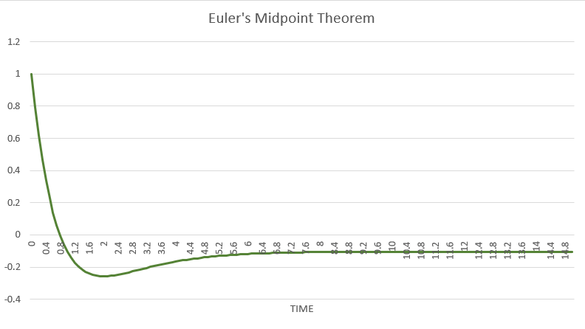
B) Euler’s Midpoint Method

Slide 18
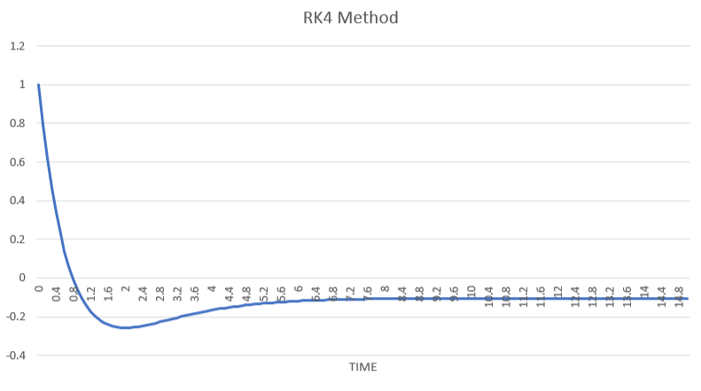
C) RK4 Method

Slide 19
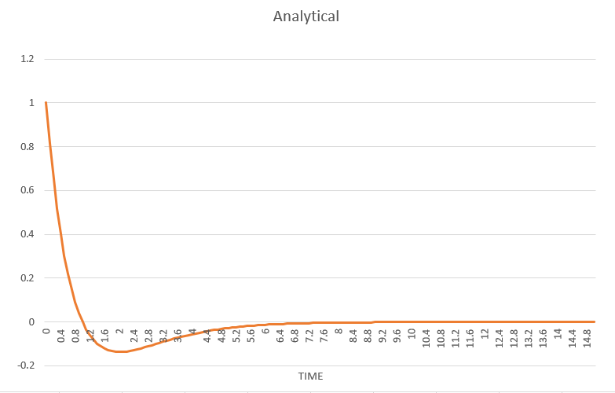
D) Analytical Method

Slide 20
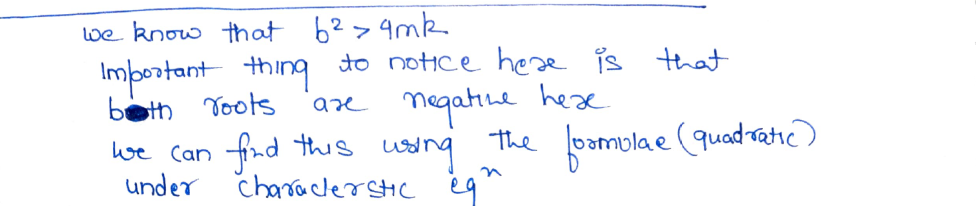
iii.) Overdamped Case (b=200)

Slide 21
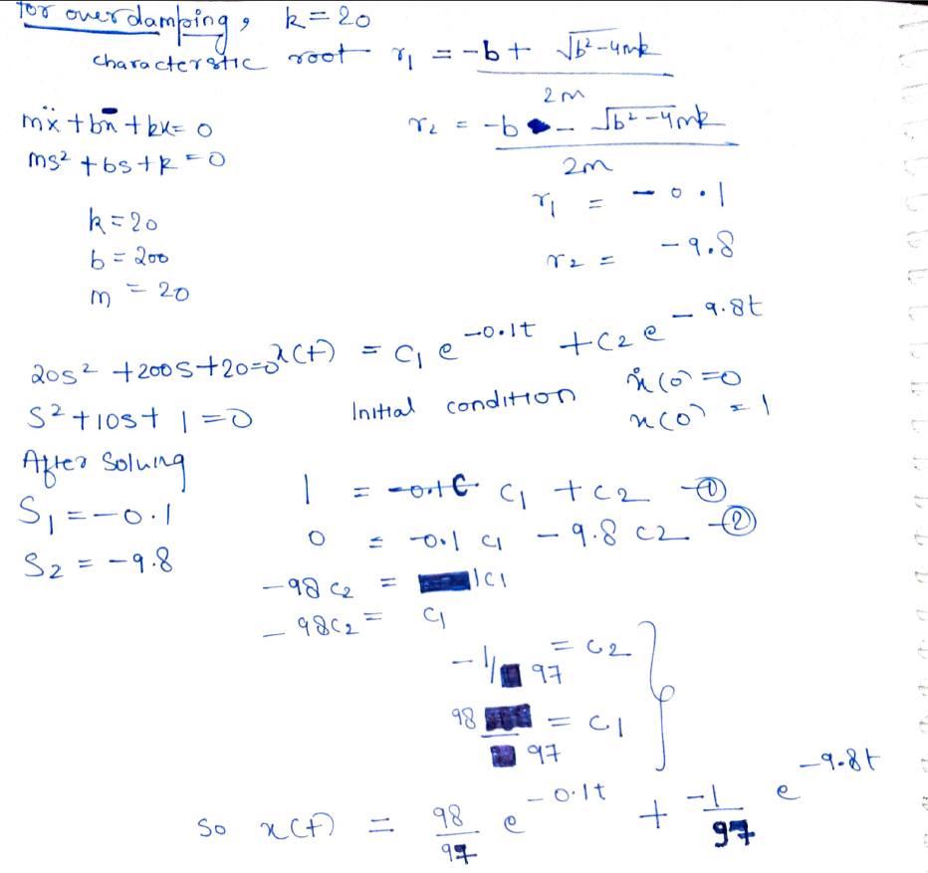

Slide 22
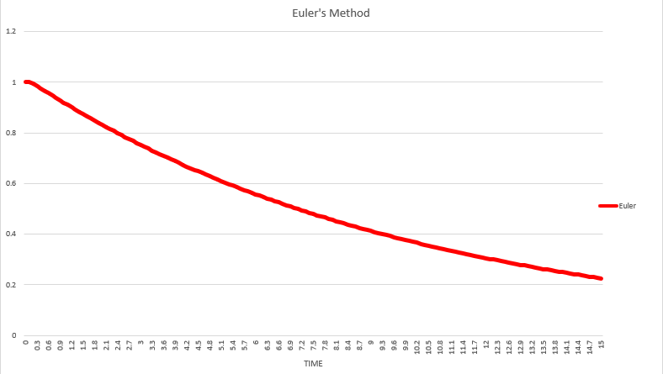
Using different numerical methods we can solve,
A) Euler’s Method

Slide 23
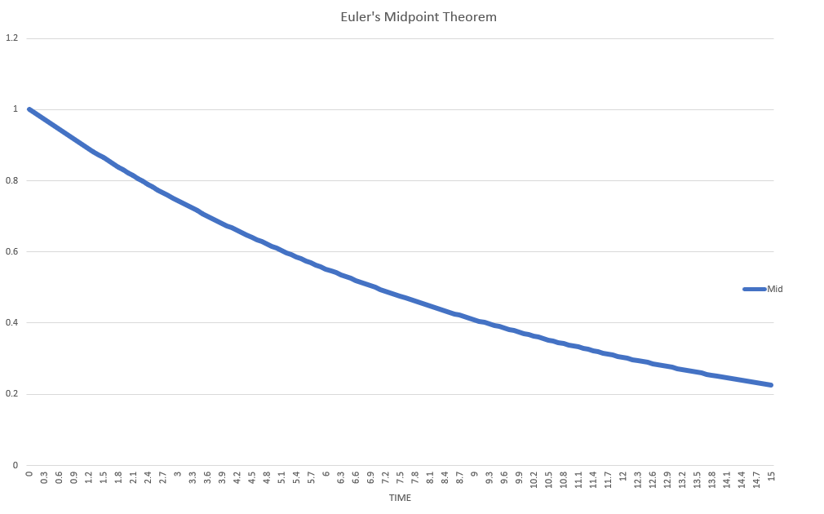
B) Euler’s Midpoint Method

Slide 24
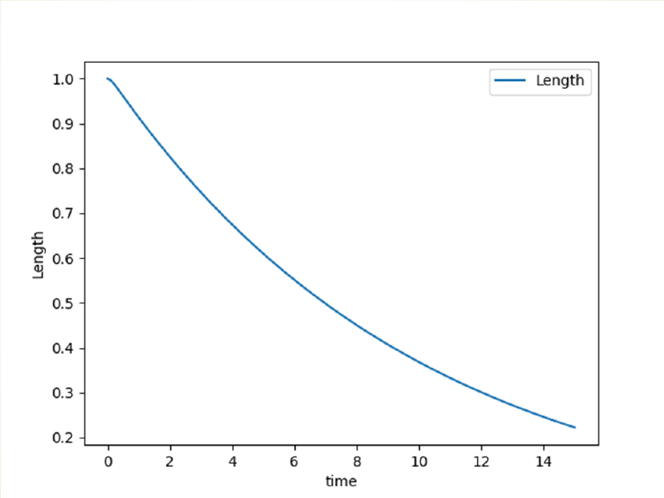
C) RK4 Method

Slide 25
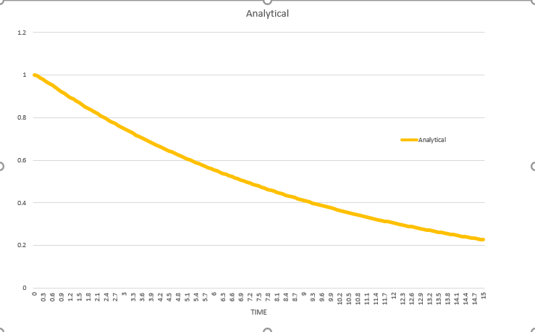
D) Analytical Method

Slide 26
2
Find the solution to the undamped, critically damped and overdamped cases for the same system using analytical method discussed in the class. Compare the numerical (Euler, Midpoint and RK4) and analytical solutions for each case with the help of a plot (A single graph should contain 4 plots, 1 for analytical and 3 for numerical).

Slide 27
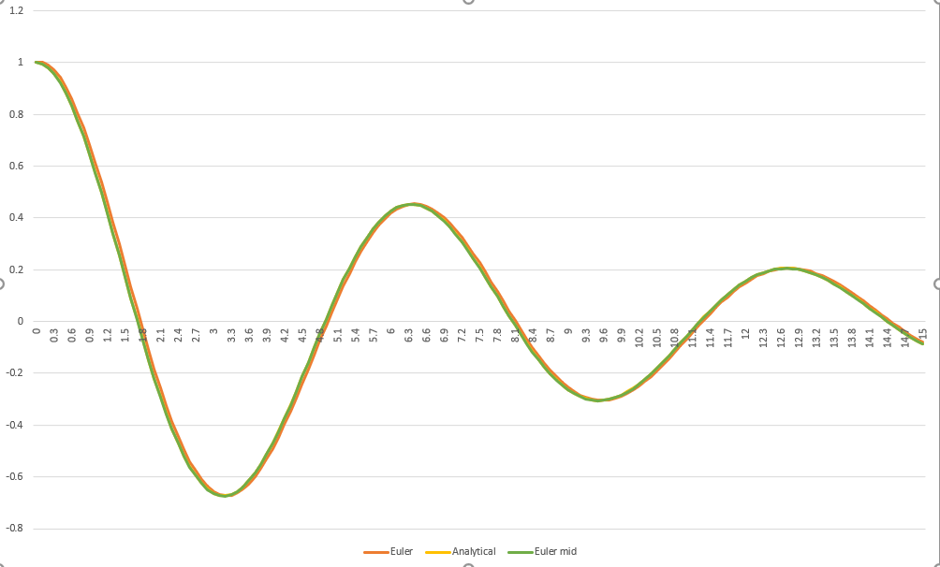
i.) Underdamped Case (b=5)

Slide 28
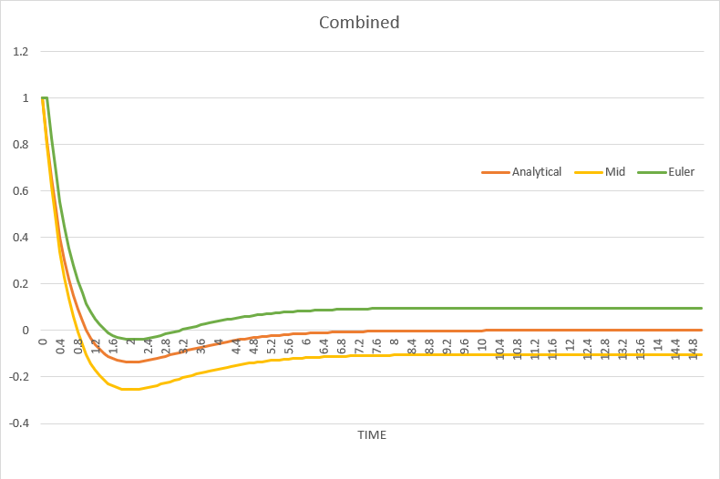
ii.) Critically damped Case (b=40)

Slide 29
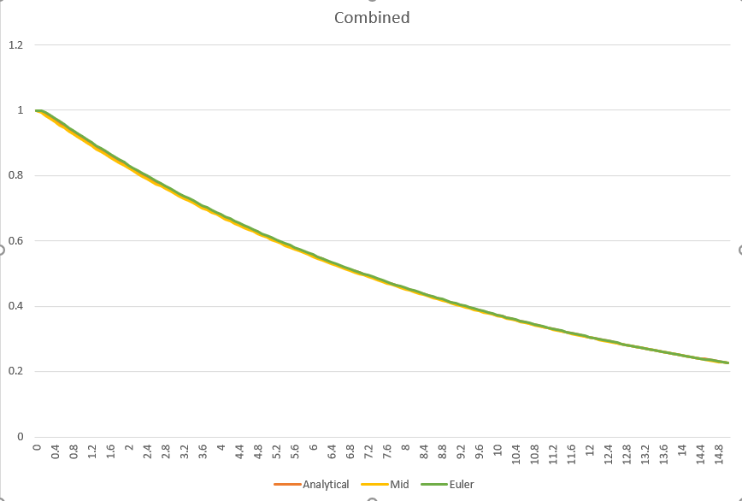
iii.) Overdamped Case (b=200)

Slide 30
RK4 is not present in combined graphs because all lines were somewhat overlapping to each other making it difficult to see the difference with naked eye.

Slide 31
Thank YOU!

